Slide 1
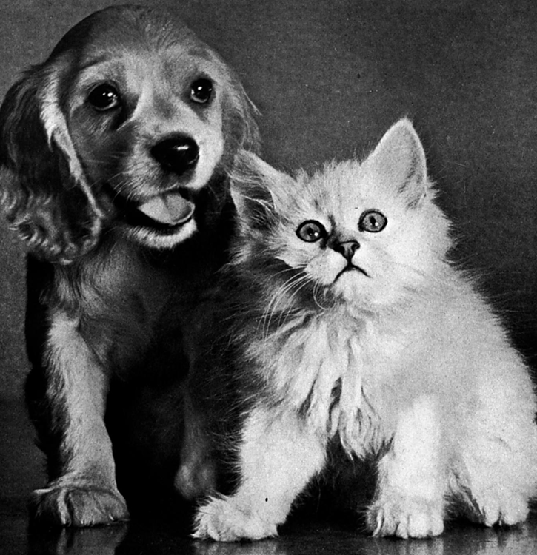
Freedom From Illness for You and Your Pets
Russell Louie
Optimum Choices, LLC

Slide 2
Russell Louie
B.S. Geophysical Engineering
Trained in aromatherapy
Certified Reiki Master
60+ years of wholistic
living experience

Slide 3
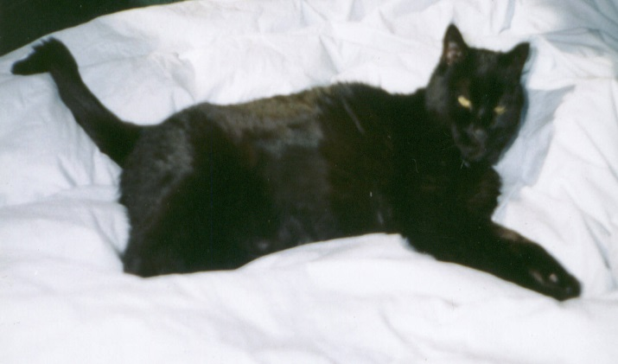
First Experience With
Bio-Algae Concentrates
Tabby, 17 years old, 10 lbs, with Chronic Renal Failure (CRF)—kidney disease, severe arthritis
Treatment: poked twice per day with subcutaneous fluids, given Standard Process RenaFood supplement, several homeopathic pills
First week:
  More energy, more affectionate
  Asked to go outside, better moods
  Increased flexibility

Slide 4
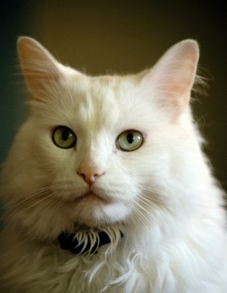
Bio-Algae Concentrates Saved Lives!
Case 1: white cat stopped eating, not producing
red blood cells (anemic) and was dying
but did not test positive for leukemia. Vets
could not diagnose the cause.
Case 2: cat had not eaten in four days and was
dying. Blood and lab tests could not find
anything abnormal. Further examination
could not find anything physically wrong
with the cat.

Slide 5
BioPreparation® Case Study
Baby Bear— 7 yr old, German Shepherd/ Husky mix, diagnosed with mast cell cancer tumor on his paw. Vet recommended the standard protocol of cutting out the entire tumor plus a
3 cm perimeter. Radiation or chemotherapy was also recommended.

Slide 6
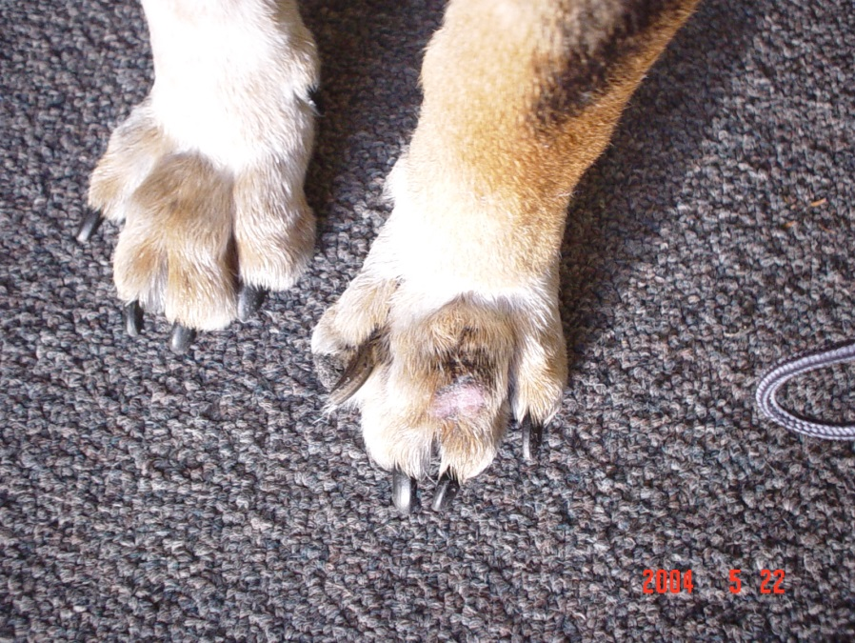
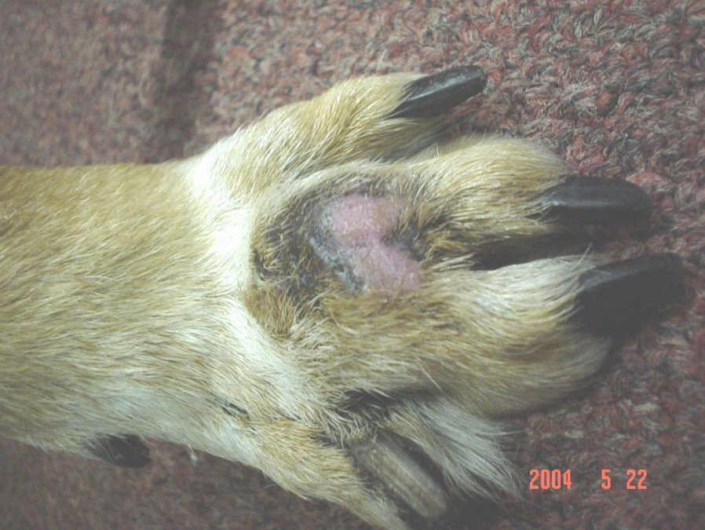
May 22, 2004 — after surgery to remove some of the mast cell tumor. Started BioPreparation® on one pinch/day.

Slide 7
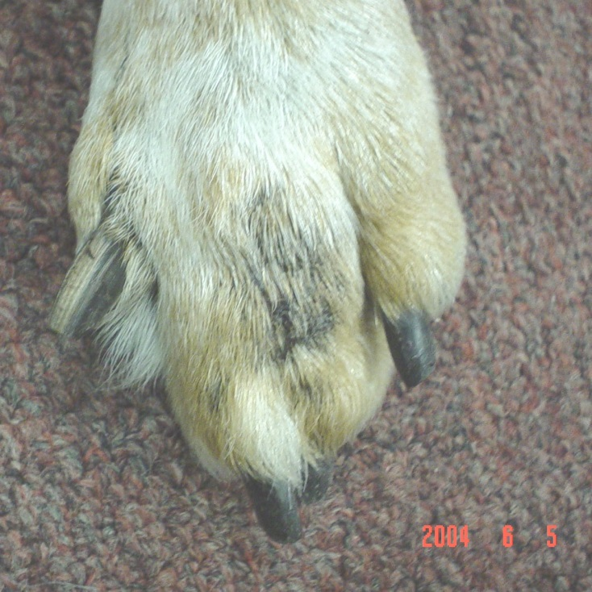
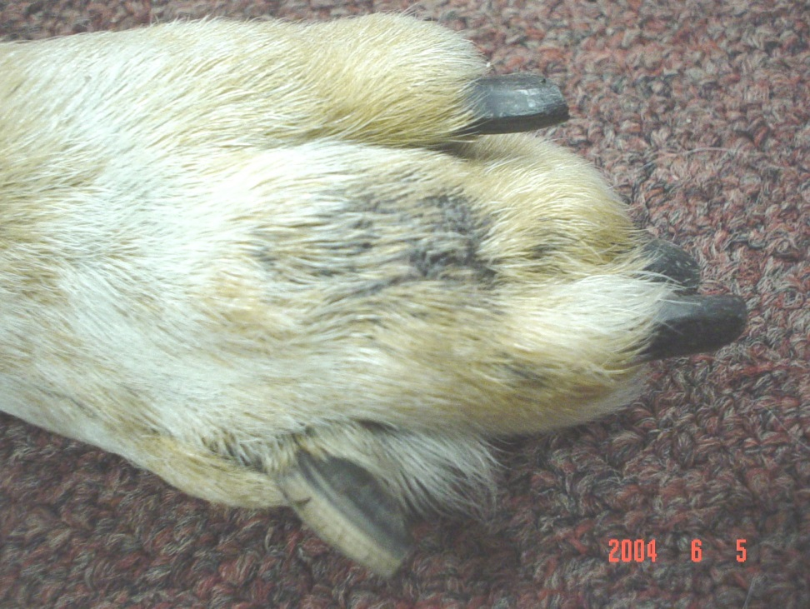
June 5, 2004 — after 15 days on BioPreparation® up to ½ capsule per day

Slide 8
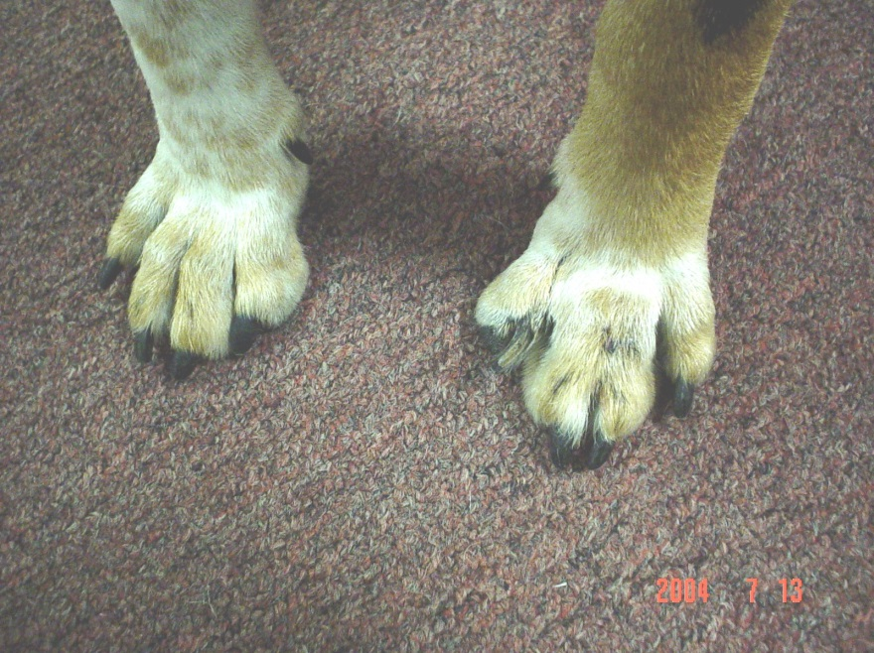
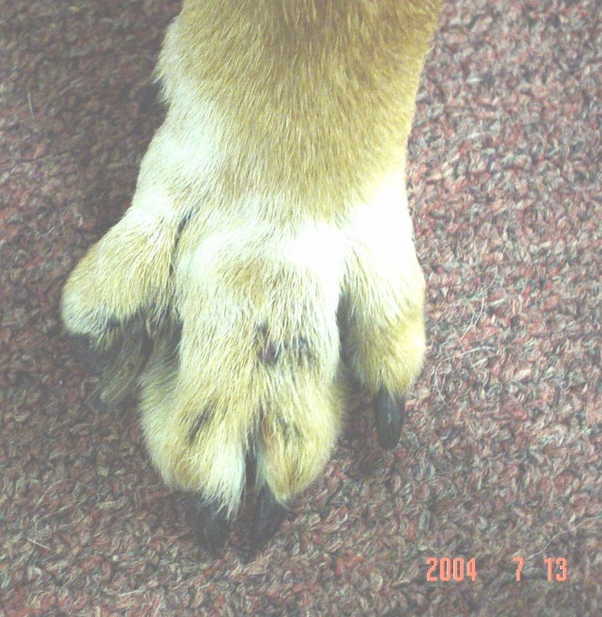
July 13, 2004 — seven weeks after starting BioPreparation® up to one capsule per day

Slide 9
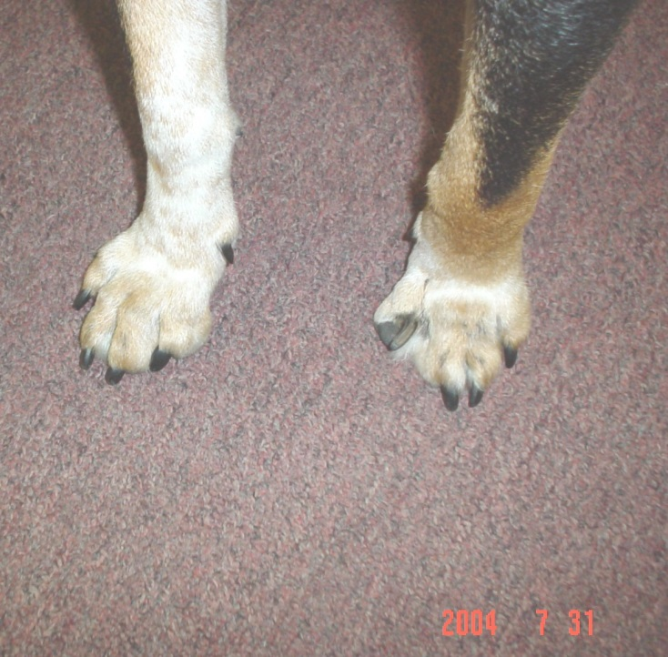
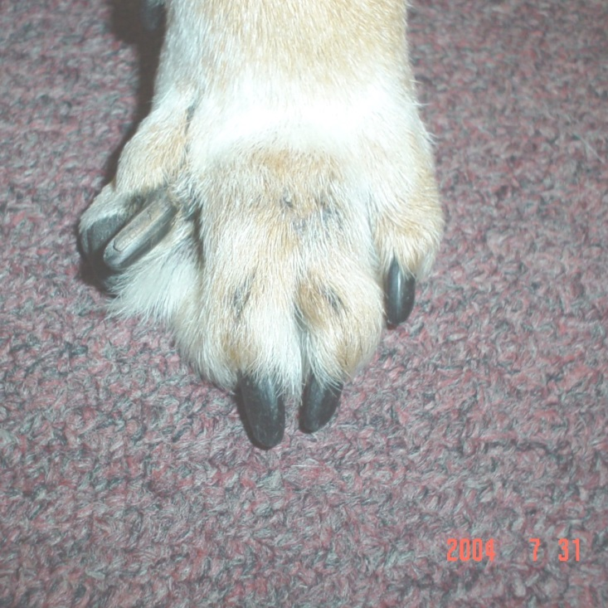
July 31, 2004 — ten weeks after starting BioPreparation® up to 1½ capsule per day

Slide 10
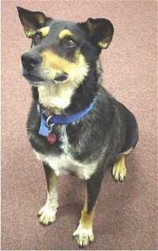
Baby Bear
Baby Bear, was given a clean bill of health on September 23, 2004. The vet report said, “Looks good. No visible recurrence of tumor. Foot regular.”
Baby Bear was adopted on September 24, 2004.

Slide 11
BioPreparation® Successes
Allergies
Auto-Immune disease
(IMHA, AIHA, SLO)
Arthritis
Diabetes
Fear & Aggression
Irritable Bowel Symptoms
Lipoma—fatty tumor
Lymes disease
Overweight & Obesity
Pancreatitis
Polyneuropathy
Seizures
Stones & Crystals
UTI
Thyroid

Slide 12


Slide 13
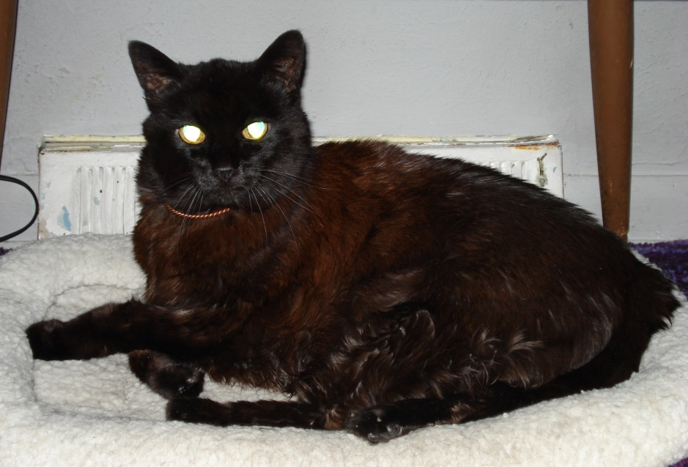
The End

